Slide 1

Dashboard Finance User Guide
August 2014
Cellia Harvey cellia.harvey@wdmgroup.com

Slide 2


Understanding Icons
This is used to edit any information and add Finance notes
Used to move Sales between tabs
Used to colour code Sales using the Description box to show what each colour means.
Colour | Description | Save

Slide 3
Summary Box
This will give you a summary of what is outstanding within the tab, as well as a breakdown of artwork using the traffic light system.
N.B the outstanding Value does NOT include any non invoiced Sales. A sale only becomes outstanding once it has been invoiced.
‘Export Tab to Excel’ can be used to extract all information into a spreadsheet
‘View Printable Version’ Allows you to print the page
Summary
Total in Tab | 30 | Tab Value | £xxx
Total Outstanding | £xxx | Liabilities | £xxx
Waiting for Copy |  |  | 17
Copy In |  |  | 0
Proof Out |  |  | 6
Approved |  |  | 7
Export Tab to Excel | View Printable Version

Slide 4
In Progress
All sales added to the sales book will automatically be added to ‘In Progress’
All invoices must be dispatched within 24 hours of sale being made. If not Finance need to speak to the Sales Person to ascertain why the paperwork has not been received.
Invoice date and invoice number must be entered into Dashboard.
The following sales must stay in ‘In Progress’ until a payment date has been agreed or Cancelled:
Accounts with known Issues
Newly invoiced or Un-Invoiced sales
Cancelled deals (Please see next slide)

Slide 5
Cancellations
Only sales for the current issue may be cancelled, and only up to 14days before Publication date (as per T&C’s)
All Cancelled deals must be removed from Dashboard within 24 hours of cancellation being agreed.
Any deals cancelled outside of the T&C’s must be done by red lining the sale on the next book. You can send a Red line request from the Finance Tab (see next slide) and it will be processed automatically
All PTP dates are fed through to the PTP graph and the ‘Promise To Pay’ Tab

Slide 6
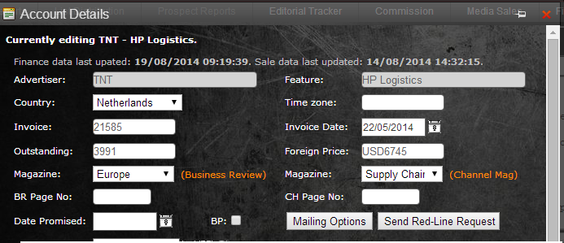
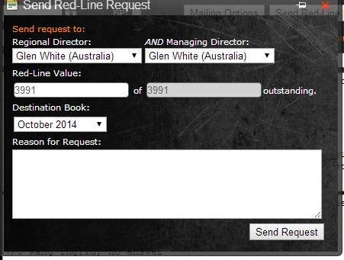
RedLines

Slide 7

Promise To Pay (PTP)
Once the customer has indicated when payment will be made you can move the sale to the ‘Promise to Pay’ tab by inputting the date they have given
If the sales person has agreed payment terms with the customer and you have confirmed the customer has received the invoice you can move it the sale to the ‘Promise to Pay’ Tab
You must follow up with the customer at the very latest the day before the Promise Date to insure the promise is still valid.

Slide 8
Proof Of Payment (POP)
Once customer has made the transfer as promised, they need to send you a copy of bank transfer as a Proof. This helps finance to match the payment and stops you from contacting the customer if they have already paid
Cheques are classed as a POP until cleared
If a customer is posting a cheque and has sent you a copy of it via email or fax with proof of postage (e.g. a Tracking number) this is also classed as a POP

Slide 9
Write Offs
These are sales where collection is no longer an option, for instance, the company has gone Bankrupt or is in Liquidation.
All write offs must be authorised by the CEO before prior to being written off.

Slide 10
Obtaining Daily Figures
Using Dashboard Tabs

Slide 11
I send figures for each region every day
AFRICA
In Progress
Payment Terms
Collectable
PTP this week
PTP next week
POP
O/S PTP
EME
In Progress
Payment Terms
Collectable
PTP this week
PTP next week
POP
O/S PTP

Slide 12
In Progress
Use the figure at the top of the ‘In Progress’ Tab
This shows the amount of Invoiced sales
Summary
Total in Tab | 19 | Tab Value | £36,161.00
Total Outstanding | £63,501.00 | Liabilities | £246,828.62
Waiting for Copy |  |  | 4
Copy In |  |  | 0
Proof Out |  |  | 5
Own Advert |  |  | 2
Approved |  |  | 8
Export Tab to Excel | View Printable Version

Slide 13
Payment Terms
If you have any accounts on Payment Terms it is recommended to colour code them for easy recognition
Colour | Description | Save

Slide 14
Collectable Accounts
I obtain the collectable figure by adding up the invoiced accounts in ‘In Progress’ that have no colour codes and no issues the you are aware of.

Slide 15
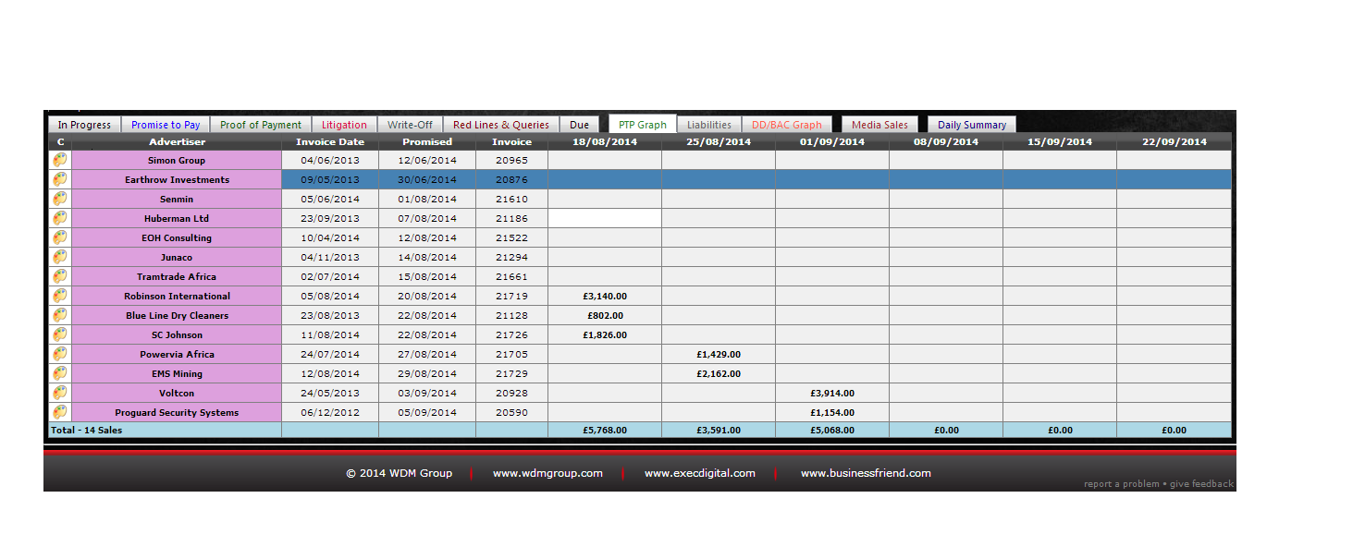
Promise to pay ‘This week’ and ‘Next week’
Self explanatory really, I use the PTP Graph tab to show what is due in and when

Slide 16
POP’s
Again self explanatory, any accounts that have proof of transfer from the POP tab are added together
Total in Tab | 2 | Tab Value | £7,111.00
Total Outstanding | £76,498.00 | Liabilities | £248,148.62
Waiting for Copy |  |  | 0
Copy In |  |  | 0
Proof Out |  |  | 0
Own Advert |  |  | 1
Approved |  |  | 1
Export Tab to Excel | View Printable Version

Slide 17
Outstanding PTP
Any PTP for the ‘Promise to Pay’ Tab that is in Red
 |  | 14/07/2014 | 16/08/2014 | IDS Next

